Slide 1
Multiview Sketching
Introduction to Engineering Design
© 2012 Project Lead The Way, Inc.

Slide 2
Multiview Drawing
Shows two or more two-dimensional views of a three-dimensional object.
Provides the shape description of an object.
When combined with dimensions, serves as the main form of communication between designers and manufacturers.

Slide 3
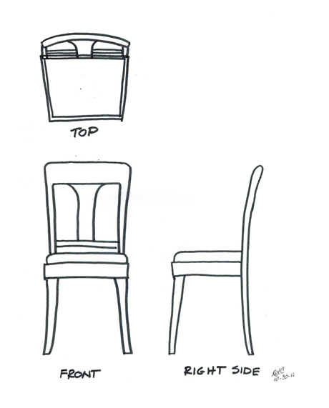
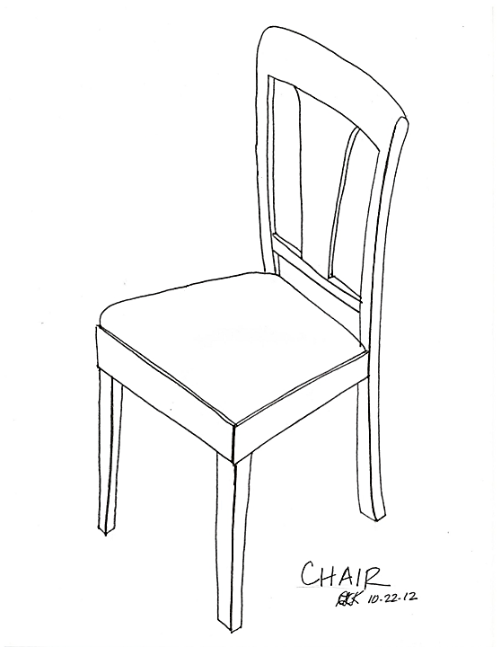
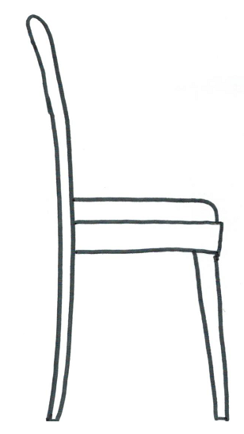
Example of Multiview Sketch
LEFT SIDE
FRONT
RIGHT SIDE
Dining Chair
Notes:
Note that hidden lines are not shown for simplicity.
Do you think the view chosen for the Front View is the best choice? Why or why not?
Remember the recommendations for how to choose a front view:
Most natural position or use
Shows best shape and characteristic contours
Longest dimensions
Fewest hidden lines
Most stable and natural position
An argument can be made for using what would be the Left Side view <click> for the Front View in that it shows the characteristic shape of the chair, but the Front View shown in the slide provides a better view of the decorative wood work on the back of the chair. Either view would suffice as a front view.

Slide 4
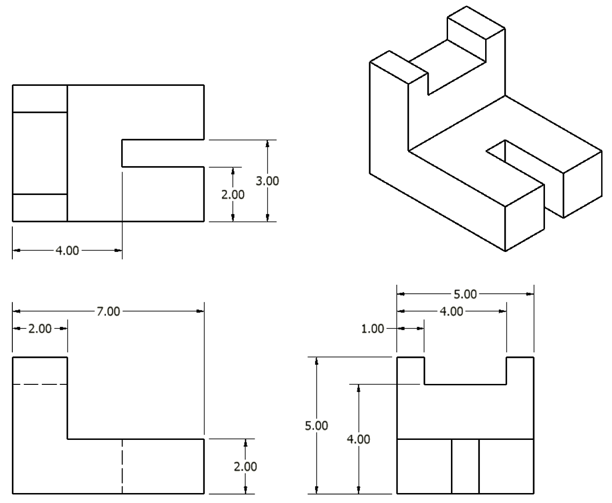
Multiview Drawing

Slide 5
Multiview Drawing
All three-dimensional objects have width, height, and depth.
Width is associated with an object’s side-to-side dimension.
Height is associated with an object’s top-to-bottom dimension.
Depth is associated with an object’s front-to-back dimension.

Slide 6
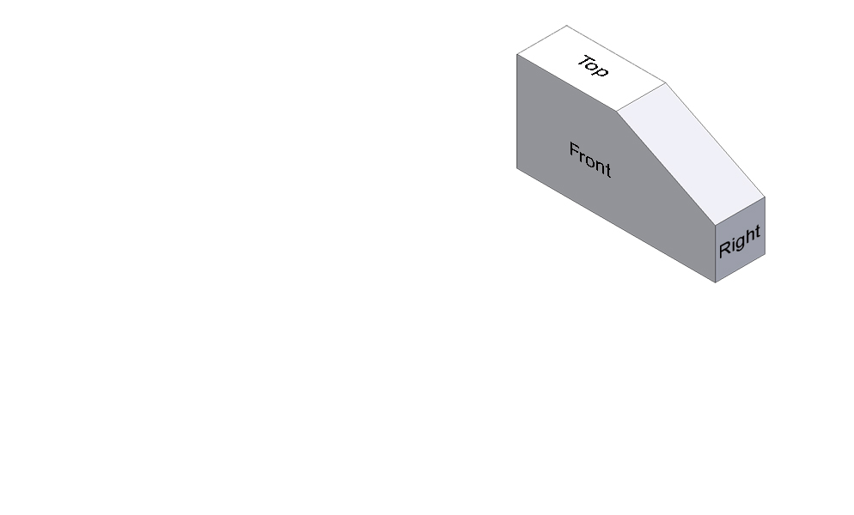
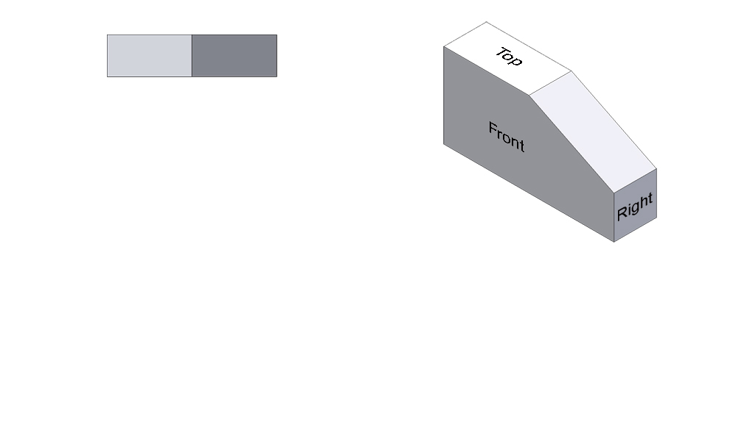
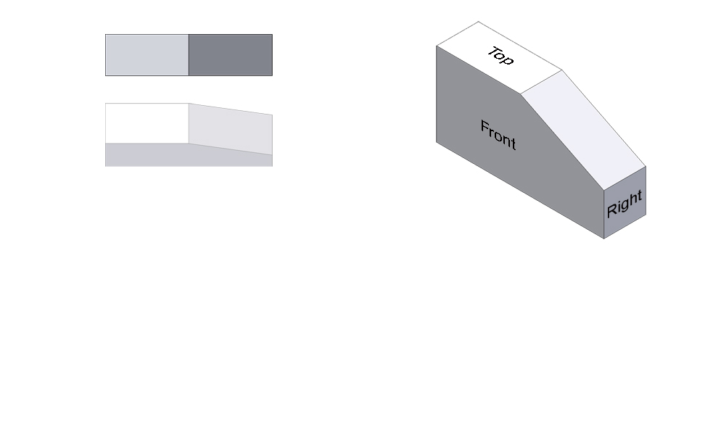
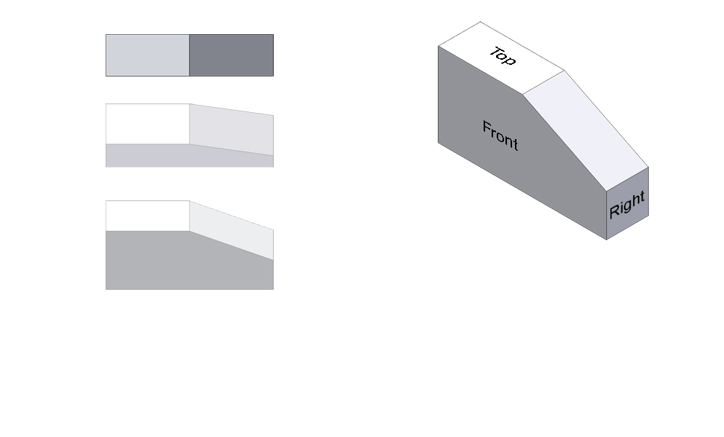
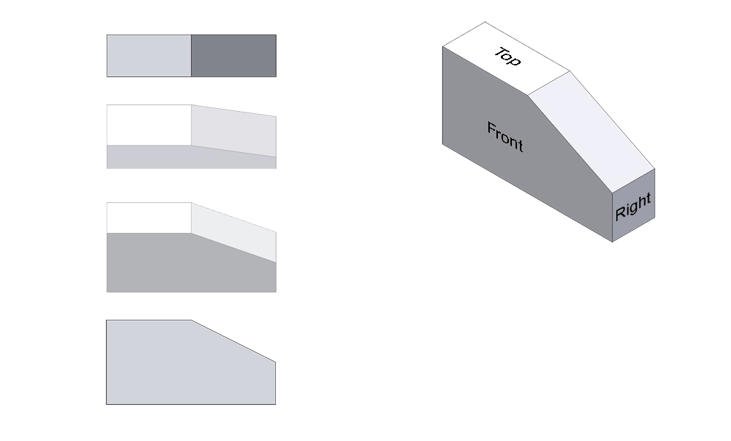
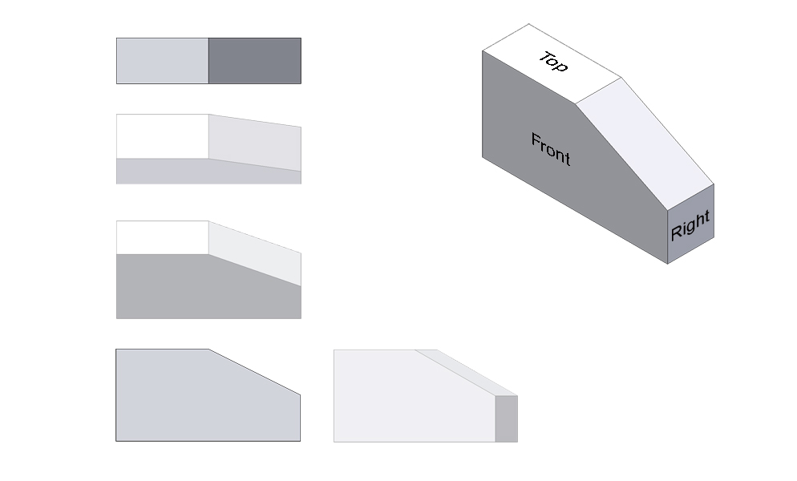
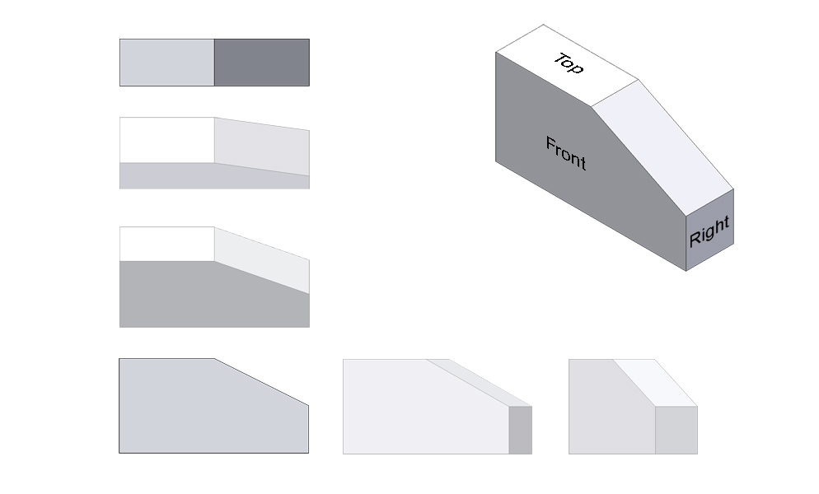
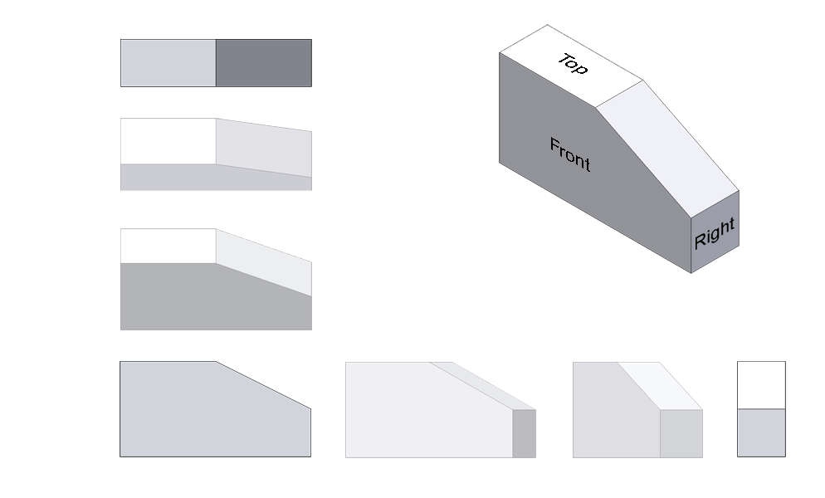
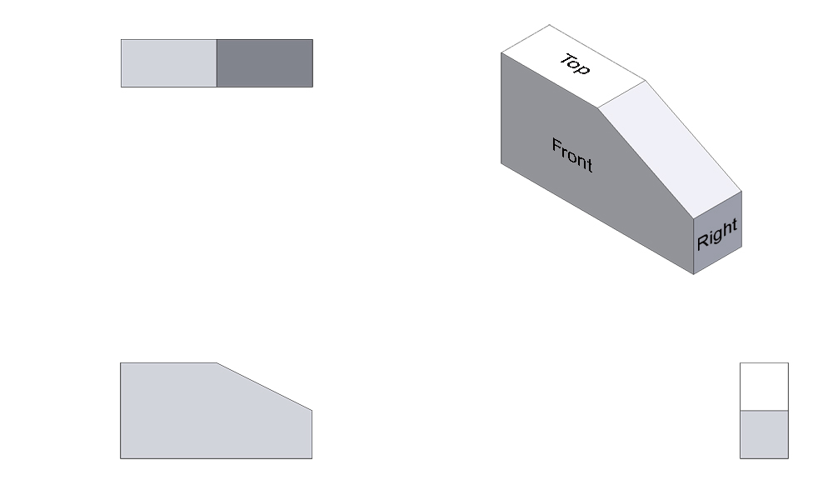
Multiview Drawing
TOP VIEW
FRONT VIEW
RIGHT-SIDE VIEW
Notes:
A typical multiview drawing includes a top view, a front view, and a right-side view.

Slide 7
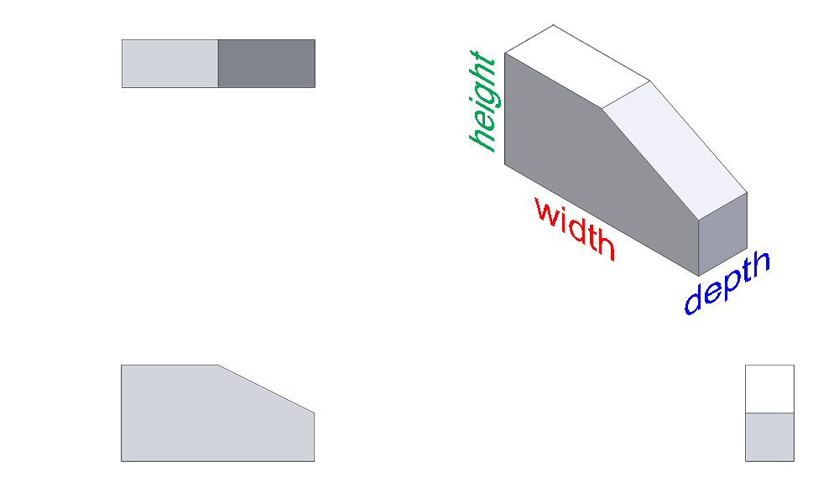
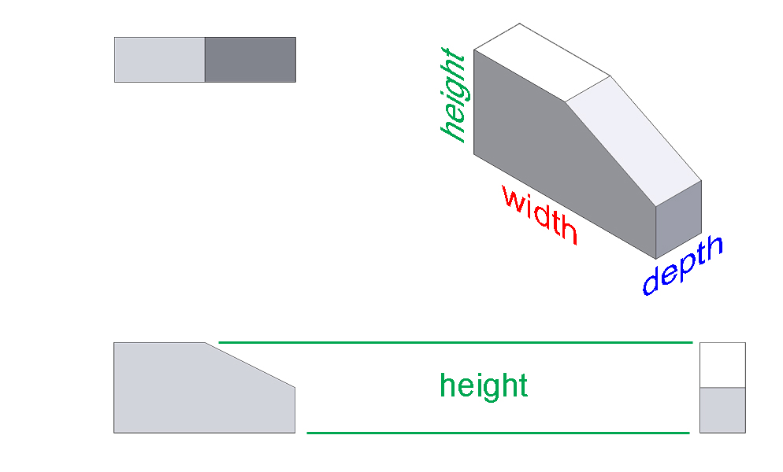
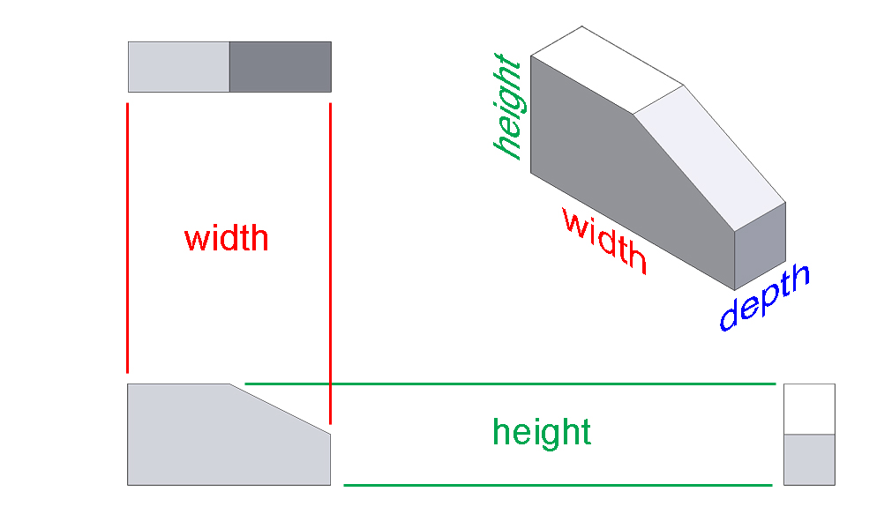
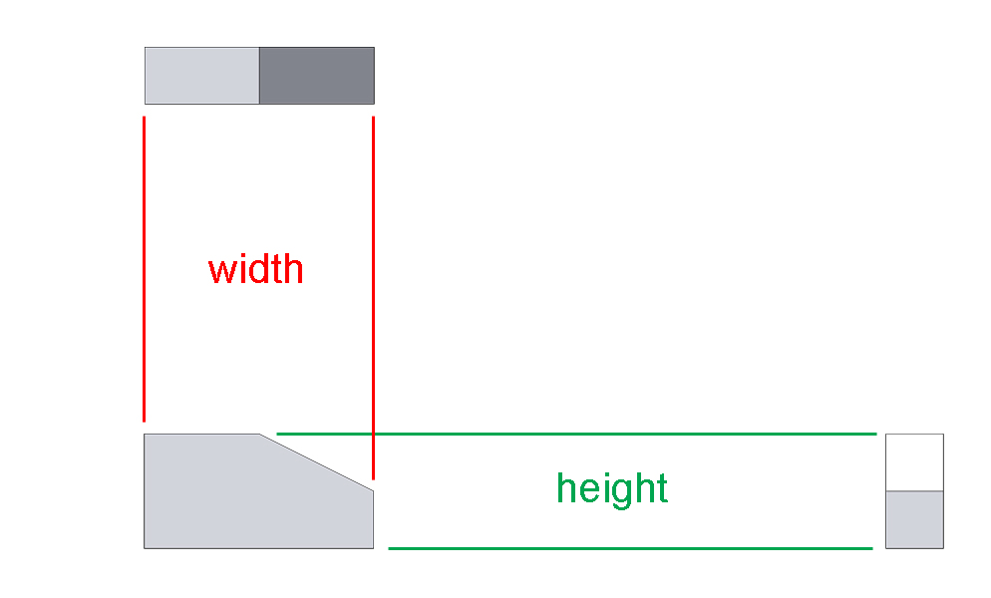
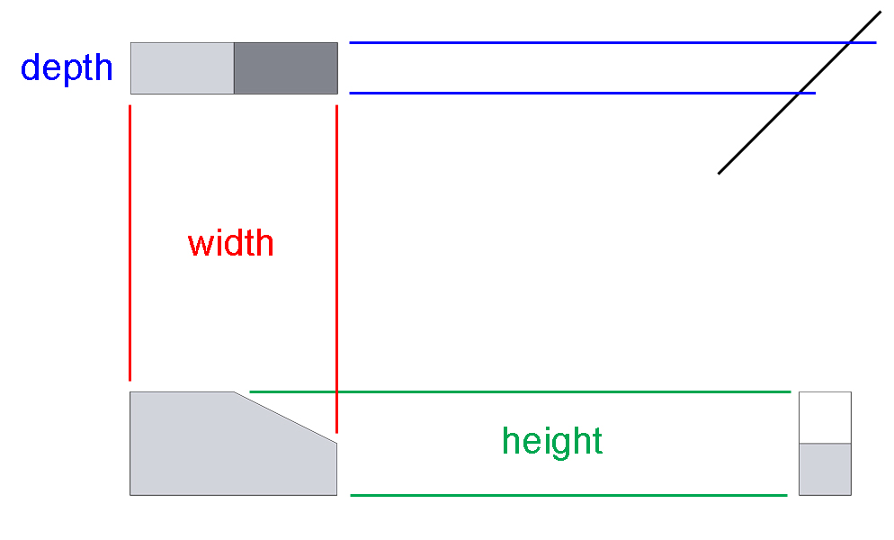
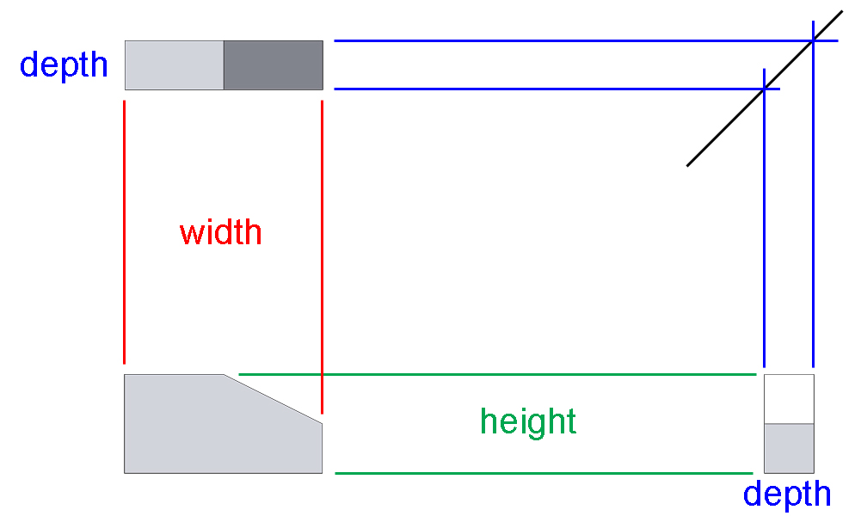
Multiview Drawing
45°
Notes:
The isometric view shows the width, height and depth of the object. The height of the object is obvious in the front view and the right-side view. The width is displayed in the front view and the top view. And the depth is shown in the top and right side. Notice how all views are aligned such that line up and construction lines can be used to help project the views from the first view drawn.

Slide 8
Orthographic Projection
A technique used to create multiview drawings.
Any projection of the features of an object onto an imaginary plane of projection.
The projection of the features of the object is made by lines of sight that are perpendicular to the plane of the feature.

Slide 9
Orthographic Projection
The best way to understand orthographic projection is to imagine an object contained inside a glass box.

Slide 10
Orthographic Projection
There is a total of six glass walls surrounding the object. Each wall represents a projection plane onto which a two- dimensional object view will be created.
Notes:
Tell Students: Notice the six glass walls that represent planes and six views can be projected from this view. Three views are typically used and they are top, front, and right side. The opposite of each view being bottom, back, and left side also exist.

Slide 11
Projection Plane
Also referred to as a plane of projection or picture plane, is an imaginary surface that exists between the viewer and the object.
The surface onto which a two-dimensional view of a three-dimensional object is projected and created.

Slide 12
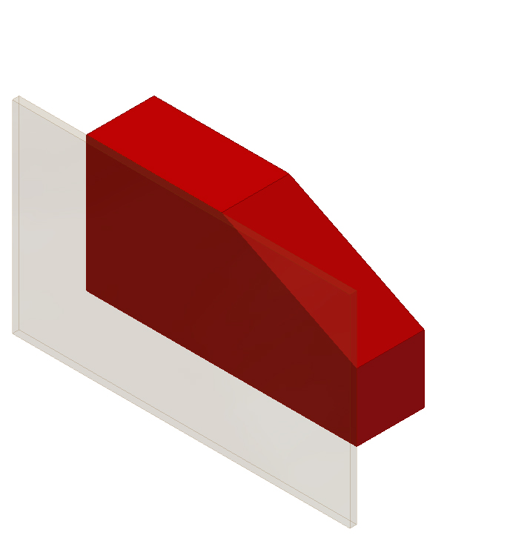
Orthographic Projection
Start by focusing only on the front projection plane.
A person standing in front of the object would see only the five corners identified in black.
2
3
1
line of sight
at 90° angle to projection plane
4
5

Slide 13
Orthographic Projection
Projection lines are used to project each corner outward until they reach the projection plane.

Slide 14
Projection Line
An imaginary line that is used to locate or project the corners, edges, and features of a three-dimensional object onto an imaginary two-dimensional surface.

Slide 15
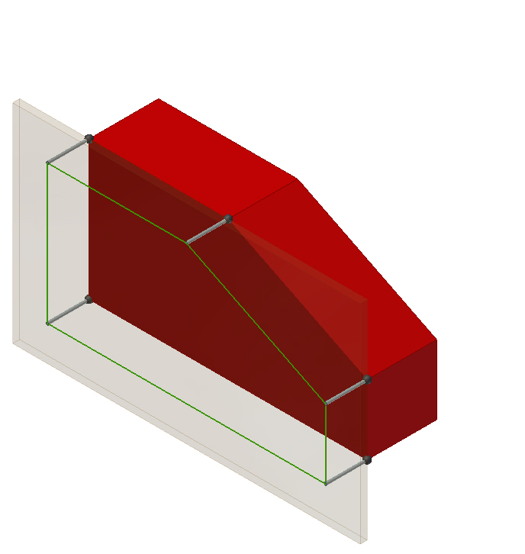
Orthographic Projection
The visible edges of the object are then identified on the projection plane by connecting the projected corners with object lines.

Slide 16
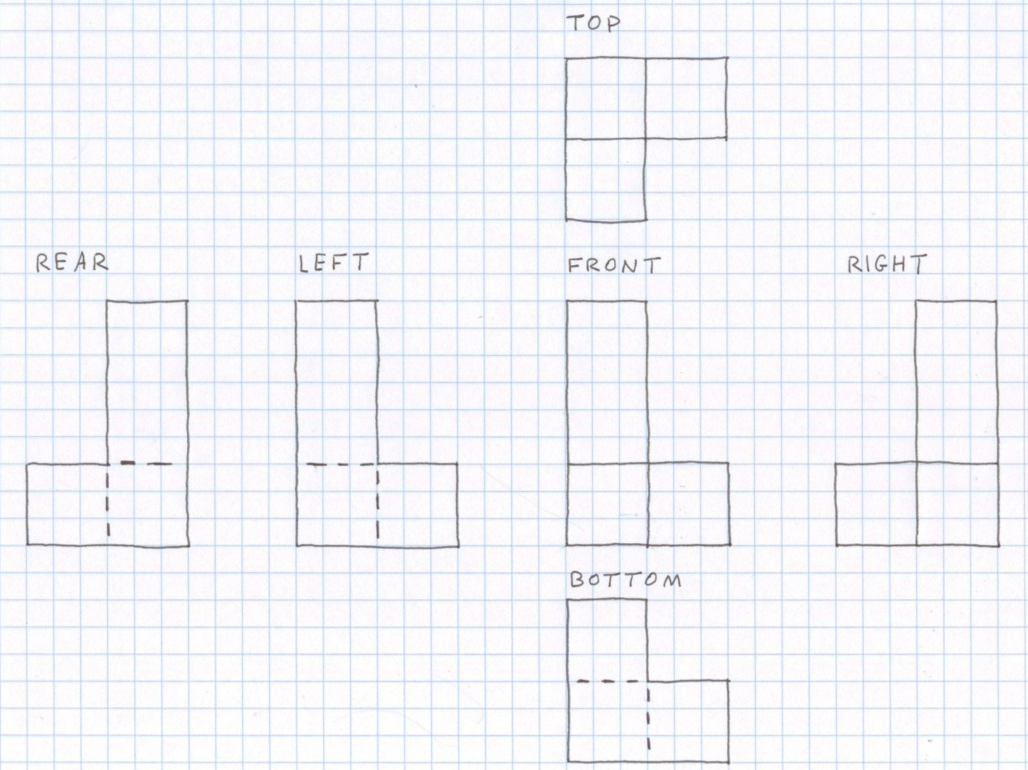
Orthographic Projection
The orthographic projection process is then repeated on the other projection planes.
Notes:
There are six principle planes as indicated here. In most cases, three or fewer orthographic projections are needed in a multiview in order to fully describe an object.

Slide 17
Orthographic View Selection
Recommendations for how to select the front view
Most natural position or use
Shows best shape and characteristic contours
Longest dimensions
Fewest hidden lines
Most stable and natural position
Notes:
The view of the side that provides the most information about the object is generally chosen as the FRONT view. Finding the best front view of a part can be difficult. Two or more sides may look like the best solution for a front view.
These are the same recommendations given in the Oblique and Isometric Pictorial presentation.
When selecting a front view, compare all side views and choose a front view based on the criteria in this list.

Slide 18
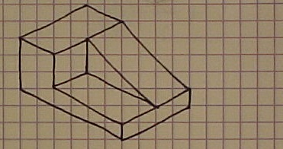
Orthographic View Selection
No hidden edges
Best shape
description
BEST FRONT VIEW
Most natural position
Longest dimension
Notes:
The front view choice dictates the pictorial orientation as well as the orthographic projection labels.

Slide 19
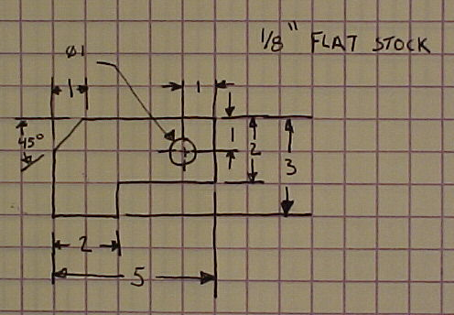
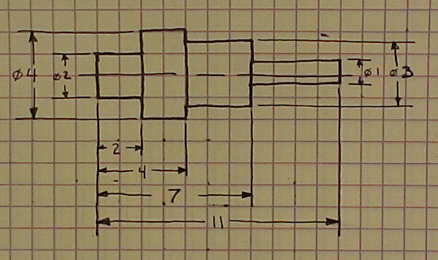
Number of Orthographic Projections
One View
Uniform thickness or shape
Two views would be identical
All dimensions properly and easily shown on one view
Notes:
Only one view may be required if the part has a uniform thickness (such as a flat plate) or a uniform shape (such as a cylindrical shape).
If two views would be identical and all dimensions are easily shown on one view, additional views may not be necessary.

Slide 20
Number of Orthographic Projections
Two Views
Symmetrical part
A third view would be identical to one other
Second view is necessary for depth
Notes:
Only two views may be required if the part is symmetrical such that a third view would be identical to another. However, a second view is necessary to show a depth that is not constant.

Slide 21
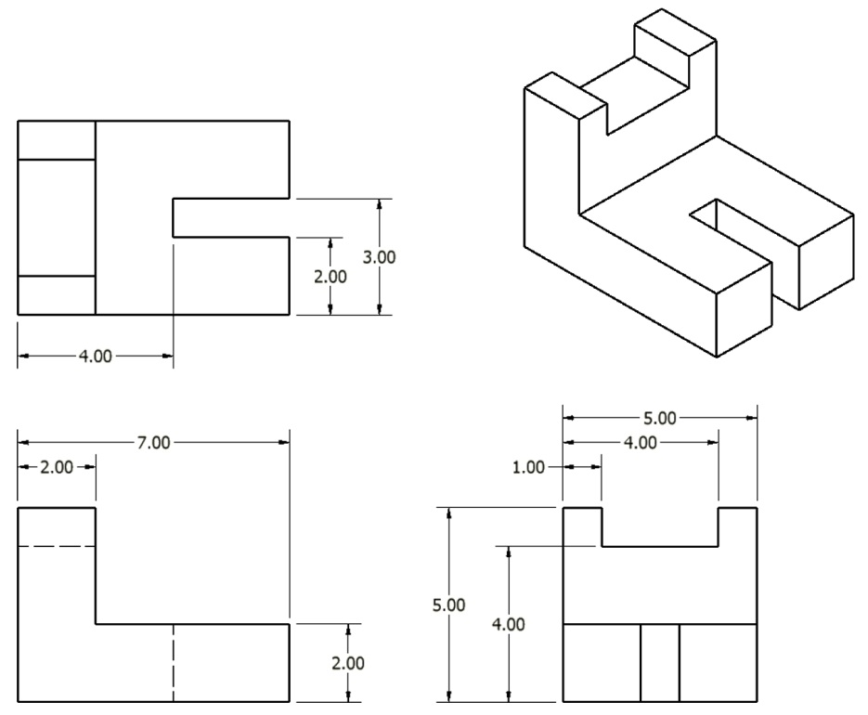
Sketching a Multiview Drawing
Given the overall dimensions of the object, a pencil, and a sheet of graph paper, sketching a multiview drawing can be easily done using points, construction lines, and object lines.
Notes:
There are several ways to sketch a multiview drawing. Feel free to use the best way that makes sense to you. Teachers may choose to explain from the board or overhead using an example and have students follow along.

Slide 22
Sketching a Multiview Drawing
Step 1 – Layout the boxes within which the individual views will occur using points and construction lines.
TOP
FRONT
RIGHT SIDE

Slide 23
Sketching a Multiview Drawing
Step 2 – Use construction lines between the views to indicate the geometry of the views.
Notes:
Three examples of edges that are translated to construction lines are shown here.

Slide 24
Sketching a Multiview Drawing
Step 3 – Identify the visible edges with object lines.

Slide 25
Sketching a Multiview Drawing
Step 4 – Locate hidden lines.

Slide 26
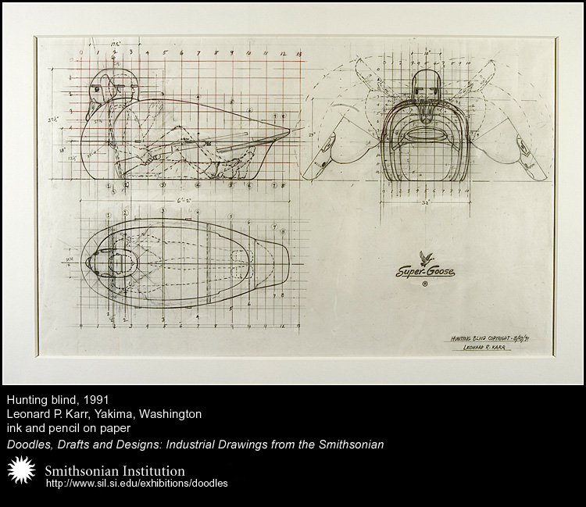
Historical Example
Leonard P. Karr (1913–1995) designed a man-sized hunting blind shaped like a goose called Super Goose, 1991.
How would you label the views presented in the drawing?
Are Mr. Karr’s views properly aligned based on the orientation presented here?
How would you rearrange the views?

Slide 27
A Question…
Each of the blocks at the right has the same overall dimensions and color. What else do they have in common?
Notes:
You could have students practice sketching the multiview drawings of these objects individually or in groups to help determine the answer before revealing it.

Slide 28
A Question…
They all have identical top views!
Each of the blocks at right has the same overall dimensions and color. What else do they have in common?

