Slide 1
Reverse Engineering and
Functional Analysis
Introduction to Engineering Design
© 2012 Project Lead The Way, Inc.

Slide 2
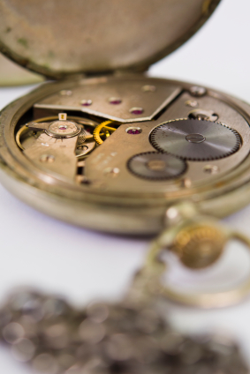
WHAT is Reverse Engineering?
Reverse engineering (RE) is the process of taking something apart and analyzing its workings in detail, usually with the intention of understanding its structure, function, and operation.
Microsoft Office clipart

Slide 3
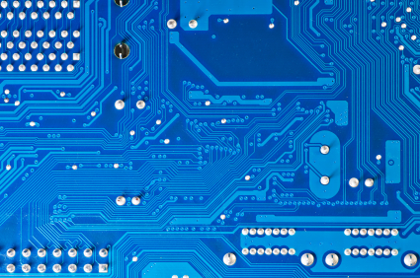
WHY is Reverse Engineering Used?
Documentation
Discovery
Investigation
Product Improvement
©iStockphoto.com

Slide 4
WHY is Reverse Engineering Used?
Documentation
No existing documentation
Interoperability
Maintenance
©iStockphoto.com
Notes:
Documentation. Sometimes, the documentation for a product, machine, or building has been lost, destroyed, never formalized, or must be transferred to a new form – such as a computer 3D model. It is often helpful to have detailed documentation of existing conditions or products readily accessible, so RE is performed in order to provide that documentation.
In order to create a device or system that will work together with another device or system (interoperability), it is essential to understand the components, function, and operation of the existing device or system. For example, integrated circuits are often designed on obsolete, proprietary systems. Therefore, if they are to be used in a new device, the IC must be analyzed.
Detailed documentation of the components and operation of existing equipment, software, or systems is often necessary in order to perform routine maintenance and repair.

Slide 5
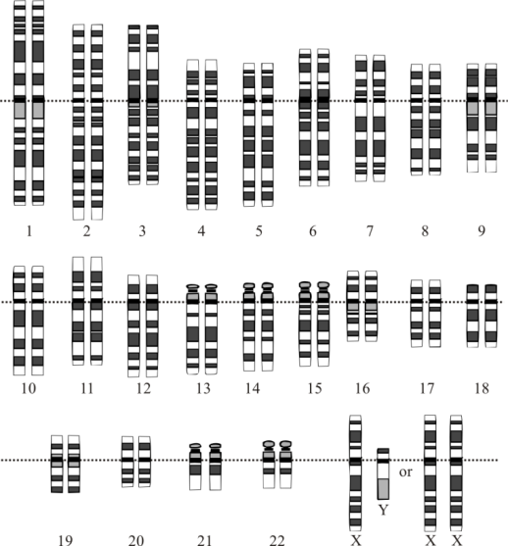
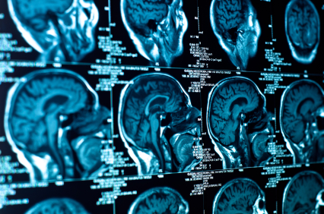
WHY is Reverse Engineering Used?
Discovery
Academic/research/learning
Curiosity
Human Genome Project
Reverse-engineer the brain
©iStockphoto.com
Source: Wikimedia, http://en.wikipedia.org/wiki/File:Karyotype.png
Modified from Human Genomne Project
Notes:
Discovery. Sometimes, learning or simple curiosity is a motivation for RE.
The National Academy of Engineering lists Reverse-engineer the brain as one of the Grand Challenges for engineering which can have huge implications in the design of artificial intelligence. The key to reverse-engineering the brain is decoding and simulating the cerebral cortex. The human cortex has about 22 billion neurons and 220 trillion synapses.
The Human Genome Project was complete in 2003. It was a 13 year project that was coordinated by the U.S. Department of Energy and the National Institutes of Health. The project identified the genes and sequenced the 3 billion chemical base pairs in human DNA. In addition, the project involved storing this data and improving tools for the analysis of the data.

Slide 6
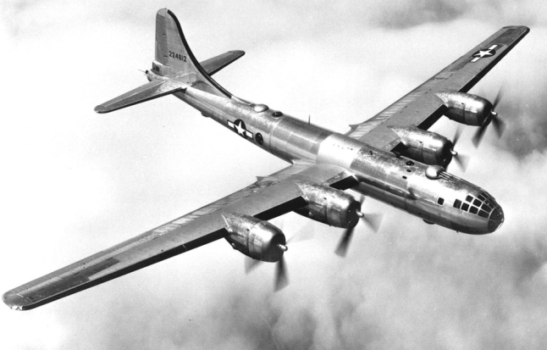
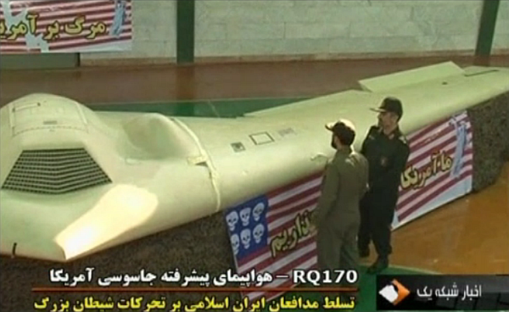
WHY is Reverse Engineering Used?
Discovery
Academic/research/learning
Curiosity
Military or commercial intelligence
B-29
RQ-170
Source: Wikimedia - http://upload.wikimedia.org/wikipedia/commons/d/d3/B-29_in_flight.jpg
Sourde:Wikimedia, author BBC
Notes:
Taking possession of enemy equipment or weapons or a competitor’s product and identifying the components, function, and operation of new technology can provide a military or commercial advantage.
In 1944 during World War II, three American B-29s made emergency landings in the Soviet Union after bombing raids over Japan. The Soviets were neutral in the Pacific War. In accordance with the Soviet-Japanese Neutrality Pact, the Soviets took possession of the bombers despite U.S. demands for the return of the aircraft. One of the B-29s was used for flight tests and training. One of the B-29s was left intact for reference. The third was reverse engineered. As a result, the Soviets built the Tu-4 as a nearly identical copy of the B-29. The Soviet engineers were under pressure to recreate an exact replica of the B-29. In fact, a small hole that was mistakenly drilled by a Boeing engineer was reproduced in every Tu-4. But some changes to the design were approved. The Tu-4 used a different engine. Because the Soviets used the metric system, the 1/16 inch aluminum sheet metal was not available. It was replaced with a thicker corresponding metric gauge metal. Therefore, the Tu-4 was more than 3000 pounds heavier than the B-29.
The RQ-170 Sentinel is an unmanned drone developed by Lockheed Martin and used by the US Air Force. The RQ-170 uses a flying wing design and is powered by a single engine that is classified. The U.S. military has released little information on the drone. They were unofficially reported to have been used to collect intelligence on enemies in Afganistan, Pakistan, and Iran, and may have provided intelligence before and during the operation which led to the death of Osama bin Laden in May 2011. In December 2011, an RQ-170 was captured by Iranian forces.
The same process is used by commercial entities to discover the components, function, and operation of a competitor’s product.

Slide 7
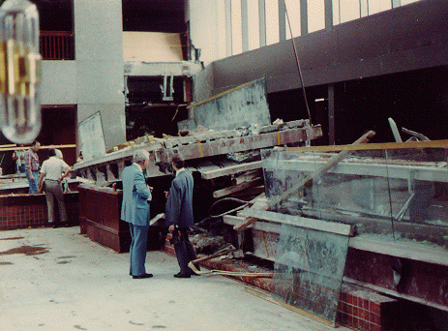
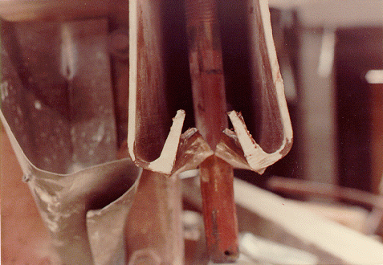
WHY is Reverse Engineering Used?
Investigation
Analysis and testing
Document patent infringement
Forensics: Design failure
Source: Wikimedia, author: Dr. Lee Lowery Jr., PE
Source: Wikimedia, author: Dr. Lee Lowery Jr., PE
Notes:
Investigation.
A product can be reverse engineered with the intent of modeling it for analysis and testing.
If a competitor releases a product that appears to included patented work, reverse engineering can be used to verify patent infringement.
If a design fails, reverse engineering is often performed to investigate the as-built conditions and to identify the mode of failure. Reverse engineering the product allows a comparison between the product design and the manufactured product. In some cases, it is discovered that the final product was improperly designed or not built to the design specifications. In other cases the cause of failure is found to be sub-standard material, fatigue, or improper use of the product.
The images show the aftermath of the Hyatt Regency walkway collapse which occurred in a Hyatt hotel in Kansas City in 1981. The disaster killed 114 people and injured more than 200. The disaster site was investigated and the structure was reverse engineered. Upon investigation it was discovered that the contractor had installed the walkway using a hanger design other than the original engineered design. Further investigation uncovered that the contractor had proposed the alternate design, which was approved by the original designer, because the original design was impractical. The alternate design did not meet building codes and was shown to be structurally inadequate.

Slide 8
WHY is Reverse Engineering Used?
Improve or redesign a product
Increase efficiency
Improve reliability
Improve manufacturing techniques
Eliminate failure mode
Reduce cost
Increase ease-of-use
Reduce negative environmental impacts
Recycle parts
Etc.
Notes:
Reverse engineering is often used to assess a product in an effort to improve the product in some way or to avoid mistakes made by previous designers – increase efficiency, improve reliability, increase product life, eliminate a failure mode, reduce cost, increase ease of use, etc.

Slide 9
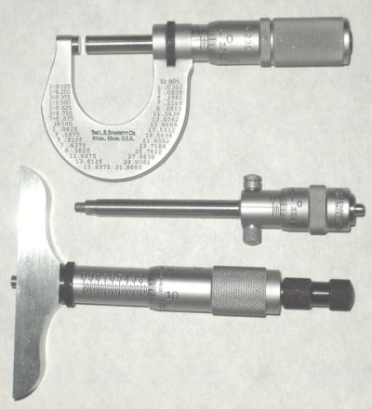
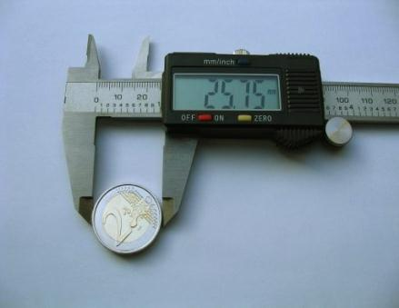
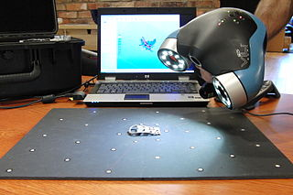
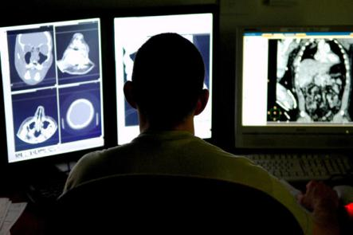
Reverse Engineering Tools
Micrometers
Caliper
Optical Probe
Source: Wikimedia, author: Christophe Cattelain.
©iStockphoto.com
Handheld 3D Laser Scanner
Source: Wikimedia, author: Splarka
Medical Imaging
Source: Wikimedia, Author: Creative Tools, License: http://creativecommons.org/licenses/by/2.0/legalcode
Source: U. S. Air Force photo/Senior Airman Julianne Showalter
Source: National Center for Computational Sciences
Notes:
If a high degree of precision is not necessary, precision instruments such as micrometers and calipers can be used by individuals.
A coordinate measurement machine (CMM) is a device used to make 3D measurements of the geometrical coordinates of an object. Often the machine can be manually controlled or computer controlled. The probes that measure the geometry can be mechanical (touch), optical, laser, or use another mode. The measurements are used to determine the position of multiple points on the object and are recorded in X, Y, and Z coordinates.
3D laser scanners are used to generate virtual model files of physical items or parts.
Many types of medical imaging devices are in use, including CT, MRI, and X-ray.

Slide 10
Stages of Reverse Engineering
Visual Analysis
Functional Analysis
Structural Analysis

Slide 11
Functional Analysis
After a product has been selected, a non-destructive functional analysis is performed.
First, the product’s purpose is identified.
Next, observations are made to determine how the product functions. These observations are recorded in detail.
Lastly, the system’s inputs and outputs are listed.

Slide 12
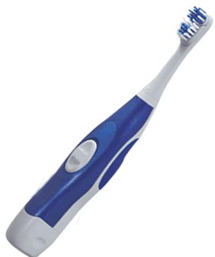
Functional Analysis Example
Purpose
The purpose of a toothbrush is to clean teeth and gums to prevent tooth and gum decay. Water and a cleansing paste are used in conjunction with the brush.

Slide 13
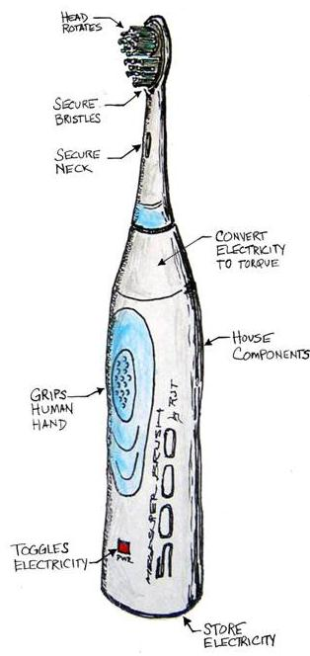
Functional Analysis Example
Function
An annotated sketch, with all visible components labeled, is created.
A hypothesis is devised to describe (in detail) the sequential operation or function of the device using the sketch as a reference.

Slide 14
Black Box Systems Model
A black box systems model is used to identify what goes into and out of the product in order to make it work as a system.
Inputs
Output
Product Function

Slide 15
Black Box Systems Model
The “black box” is used to represent the product’s internal components or processes, which are deemed unknown at this point.
Inputs
Output
Product Function

Slide 16
Functional Analysis Example
Sound
Heat
Waste
Clean teeth and gums
Hand Motion
Toothpaste
Water
Energy
Inputs
Output
Product Function

