Slide 1
Product Disassembly
Introduction to Engineering Design
© 2012 Project Lead The Way, Inc.

Slide 2
Product Disassembly
Disassembly or teardown of a product is a major step in the reverse engineering process
It uncovers the principles behind how a product works
It is always fun to tear apart a product, but nothing will be accomplished if data is not collected during the process
To gather this data, we will use a Product Disassembly Chart

Slide 3
Answer the Following Questions
How do the parts interact?
What are the good and bad features of the product?
Form
Function
What has caused the product to succeed or fail?
Are the materials appropriate?
What manufacturing process was used?
What is the estimated cost of the product?

Slide 4
Why Disassemble a Product?
To identify components and interaction of components
To determine strength and weaknesses of parts
To understand the operation
To develop (computer) documentation

Slide 5
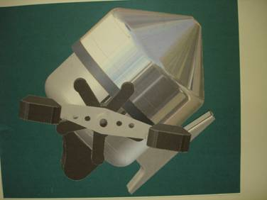
Initial Product Selection
A product is selected for RE
The product can range from simple (child’s toy) to complex (fishing reel)

Slide 6
Suggested Supplies for Disassembly
Small drill
Calipers
Screwdriver set
Socket set
Wrenches
Wire cutters
Needle nose and regular pliers
Radius gauge
Hand saw / miter box and back saw
Scale
Protractor
Handout – Product Teardown Chart
Hand tool to compress springs
DO NOT DESTRUCTIVELY DISASSEMBLE AN AUTOMOBLOX VEHICLE

Slide 7
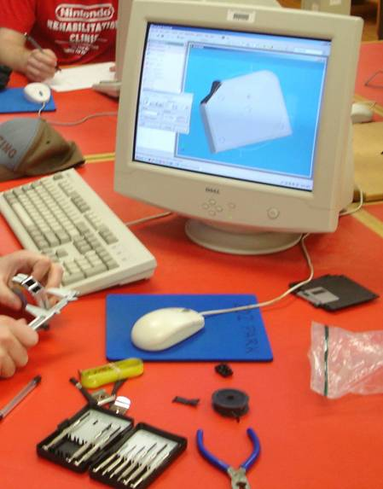
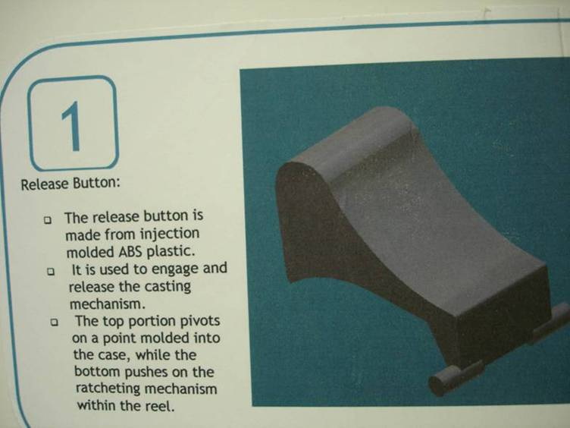
Product Disassembly and Documentation Procedure
Disassemble the product
Create pictorial sketches to describe the operation
Carefully observe and measure each part
Record your finding on the Product Disassembly Chart
Create an annotated sketch of each part
Compare your hypothesis for operation to the actual operation of the part
Create 3D solid models for each part
Document your findings

Slide 8
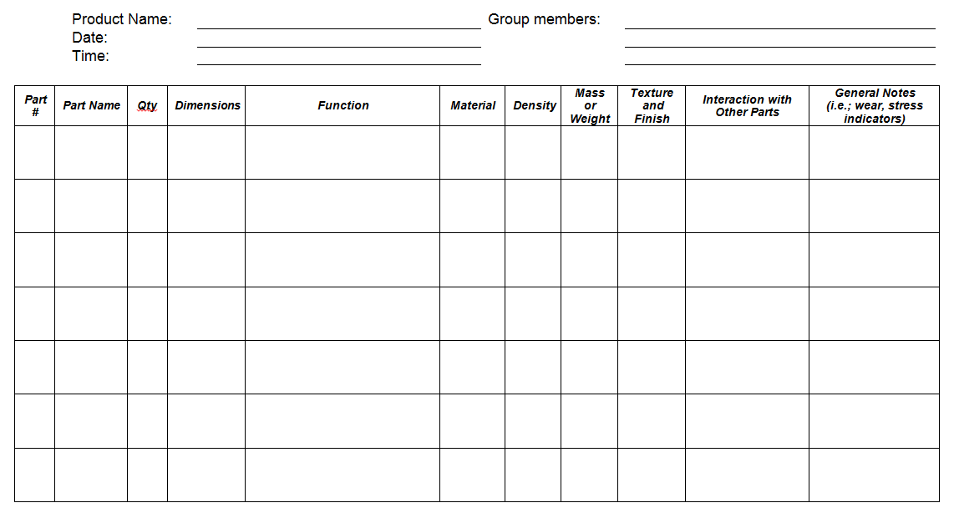
Product Disassembly Chart

Slide 9
Answer the Following Questions
How do the parts interact?
What are the good and bad features of the product?
Form
Function
What has caused the product to succeed or fail?
Are the materials appropriate?
What manufacturing process was used?
What is the estimated cost of the product?
Notes:
Remember to address these questions as you work through the disassembly process.

Slide 10
Product Disassembly Display Example
Notes:
You may later be asked to create a Product Disassembly Display.

Slide 11
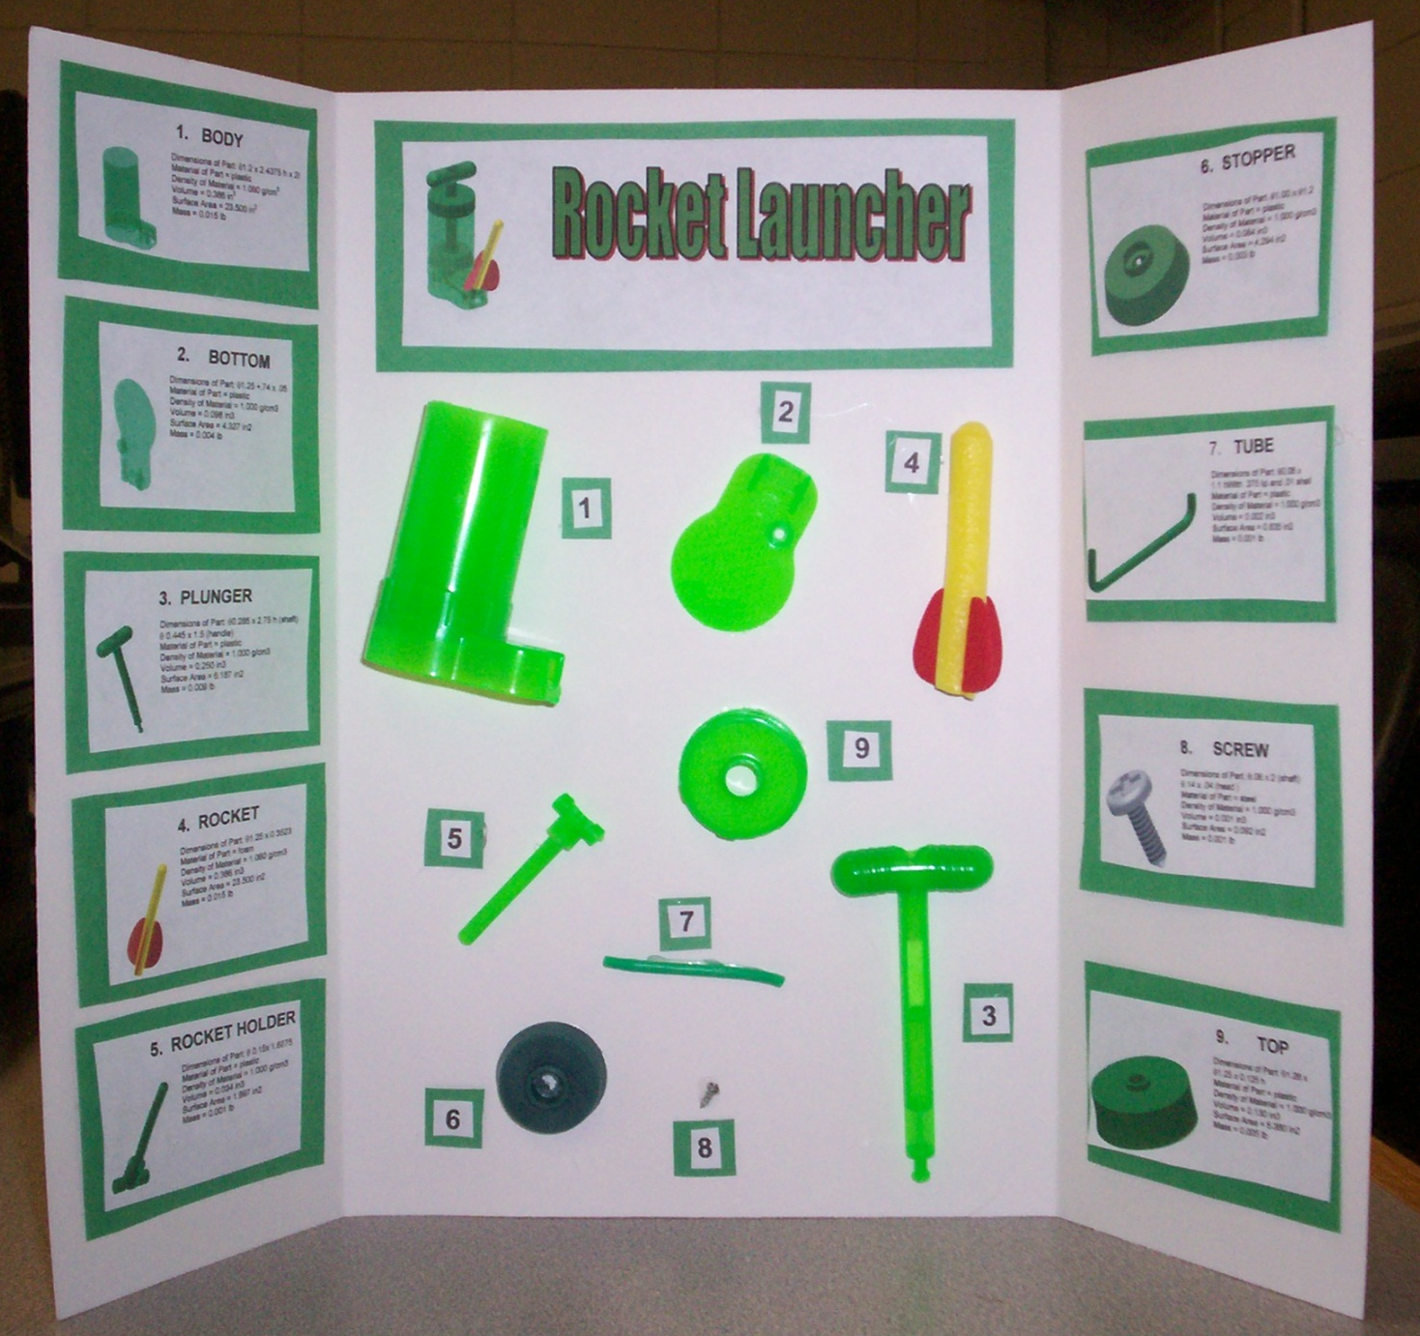
Product Disassembly Display Example
Notes:
You may later be asked to create a Product Disassembly Display.

Slide 12
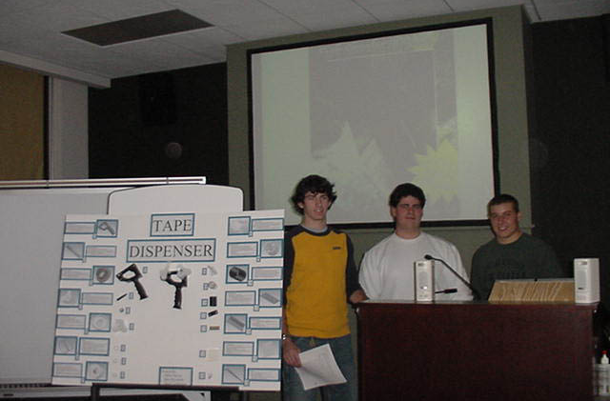
Product Display Presentation
Notes:
You may be asked to present the findings of your reverse engineering project.

Slide 13
References
Ashby, M., & Johnson, K. (2002). Materials and design: The art and science of material selection in product design. Butterworth-Heinemann
Dominick, P. G., et al. (2000). Tools and tactics of design. John Wiley and Sons.
Ingle, K. A. (1994). Reverse engineering. NY: McGraw-Hill.
New Product Development Solutions. (n.d.). Retrieved from http://www.npd-solutions.com/
Otto, K., & Wood, K. (2001). Product design: Techniques in reverse engineering and new product development. Upper Saddle River, NJ: Prentice Hall.
Samuelson, P., & Scotchmer, S. (2002).The law and economics of reverse engineering. Yale Law Journal. Retrieved from http://www.yale.edu/yalelj/111/111-7ab2.html

