Slide 1
Alternate Views
Introduction to Engineering Design
© 2012 Project Lead The Way, Inc.

Slide 2
Alternate Views
In some cases, orthogonal projections and pictorials are not sufficient to specify all the details of a part.
Section View. Used to show “inside” details not apparent on the exterior of the part
Auxiliary View. Used to show features that are located on an inclined surface in true size and shape
Detail View. Used to show a “close-up” view of features that are too small to adequately specify in another view

Slide 3
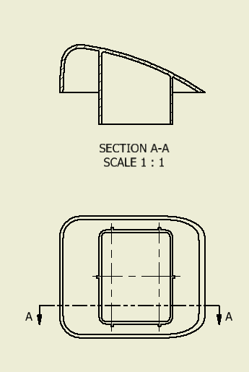
Section View
Provides a view of an object as if it were cut by a saw
Location is indicated by a cutting plane line on another view
Cutting plane line

Slide 4
Section View
Cutting plane line
Indicates location of the cut
Thick and broken line
Arrows indicate direction of view
Labeled with a letter for identification on drawing
Cutting plane line

Slide 5
Section View
Section lines
Hatch lines that indicate material that was “cut” at the cutting plane line
Thin lines
Section lines
Cutting plane line

Slide 6
Section View
Types
Full Section
Half Section
Offset Section

Slide 7
Full Section
Cutting plane line passes fully through the part
The part of the object behind the cutting plane line (away from the direction of the arrows) is removed

Slide 8
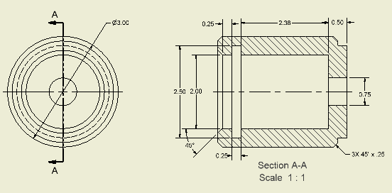
Full Section Example
Section lines indicate material that is cut by the cutting plane line
Imagine the part is cut at cutting plane line
Direction of View
This half of the part is removed

Slide 9
Full Section Example
Section lines indicate material that is cut by the cutting plane line
Imagine the part is cut at cutting plane line
Direction of View
This half of the part is removed

Slide 10
Half Section
Used on symmetrical parts to show inside as well as outside details in one view
One quarter of the part is cut away
Cutting plane line goes halfway through the part

Slide 11
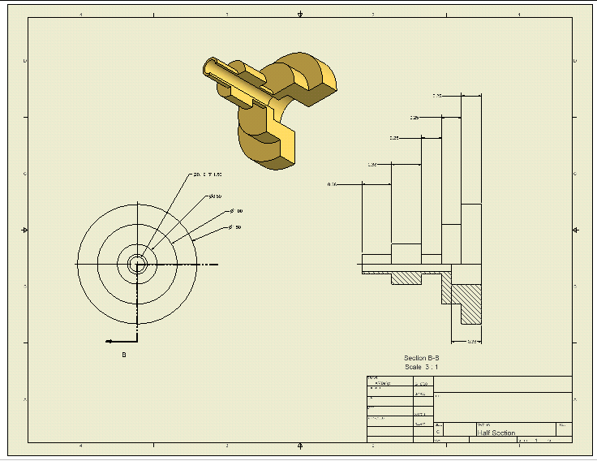
Half Section Example
Only one arrowhead in the direction of view
Note that the cutting plane line cuts away a quarter of the part
Half Section

Slide 12
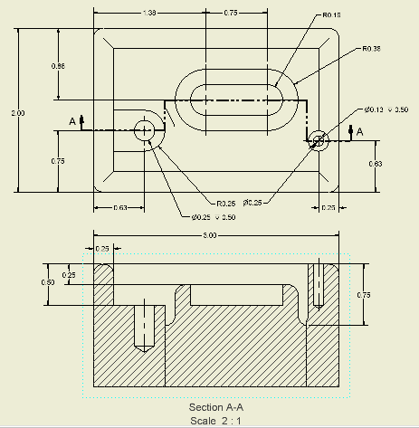
Offset Section
Interior features not in line with each other can be shown in an offset section view
Note how the cutting plane line changes direction and follows the center of each feature

Slide 13
Auxiliary Views
Orthographic projection of an inclined plane (angled surface) which appears foreshortened in a principle orthographic projection
Used to show the true size and shape of an inclined plane and the features on it

Slide 14
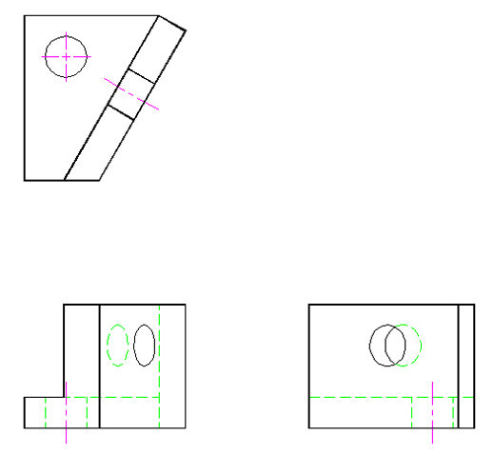
Auxiliary Views
Foreshortened surfaces do not give a clear or accurate representation of the size or shape of the surface or features and should not be dimensioned
foreshortened face
TOP
FRONT
RIGHT SIDE

Slide 15
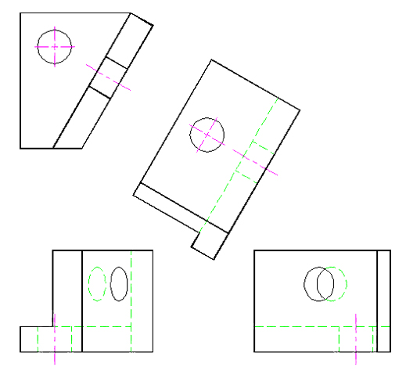
Auxiliary Views
An auxiliary view allows the viewer to look perpendicular to an angled surface to witness the true size and shape of that surface and its features (a hole in this example).
True Height
Auxiliary Distance
TOP
FRONT
RIGHT SIDE
Notes:
We will not use auxiliary views in this unit, but they will be presented in more detail in Unit 8.

Slide 16
Detail Views
An enlargement of a portion of another view to illustrate small features on a part
Not to be confused with a Detail Drawing which is any drawing that contains all the information needed to manufacture a part

Slide 17
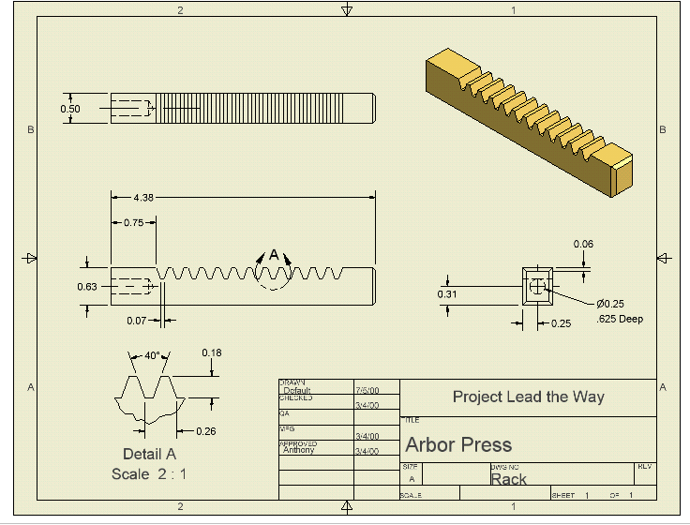
Detail View Example
A feature is broken out and enlarged for clarity

